Slide 1
Cairn Alumni Web Application User Guide
by Tyler Carrier

Slide 2

Login
Simply input username and password to login
If you have not yet created an account with us, click the register link

Slide 3
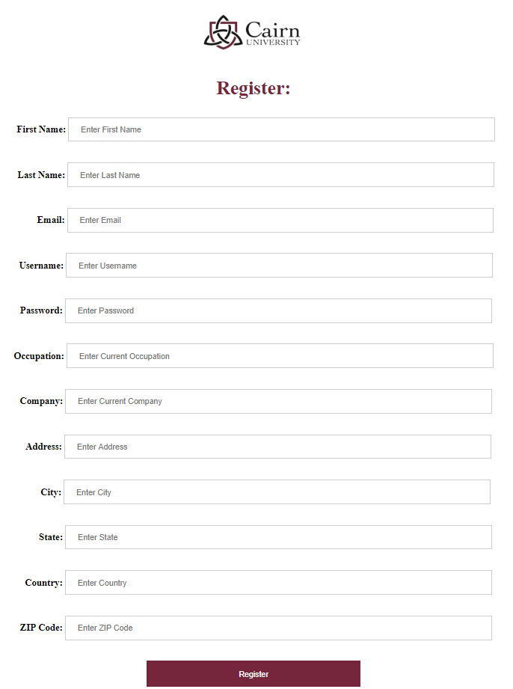
Register Alumni User
Fill out provided fields and click the “Register” button. Your account will be created, and you will be provided with a portal to Cairn Connect

Slide 4
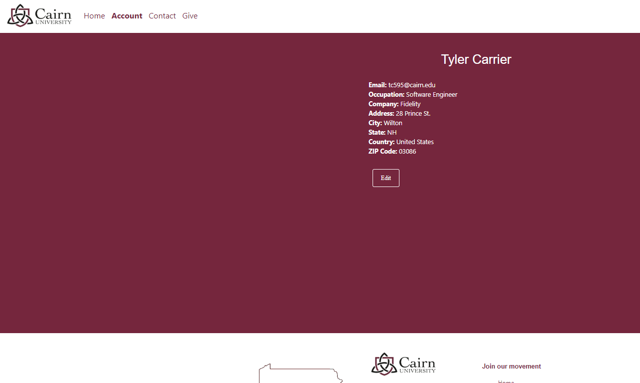
Profile Page
You will be directed to page where you are able to view or edit your information
Click the “Edit” button to edit information

Slide 5
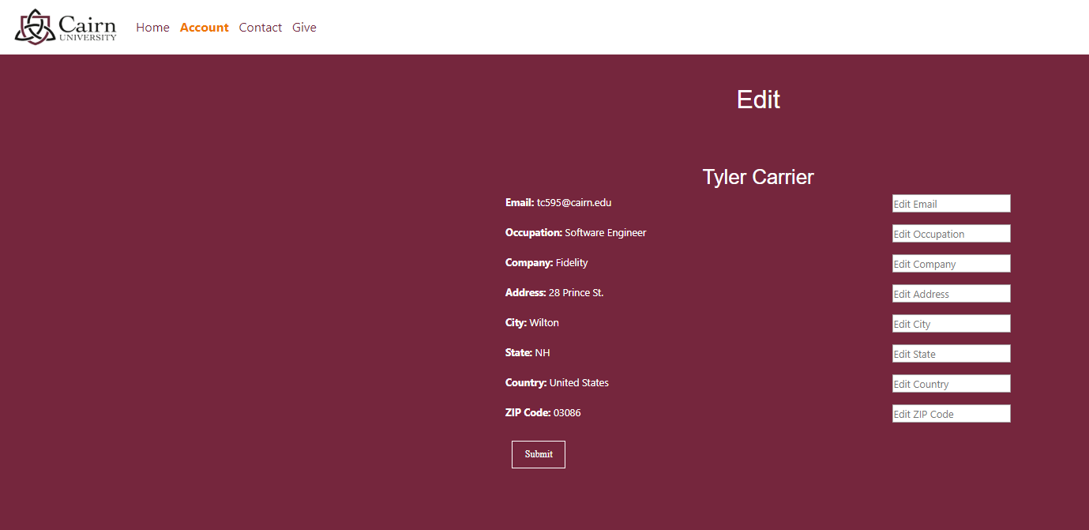
Edit Profile Info
Fill in information in provided fields and click submit to complete updates

Slide 6
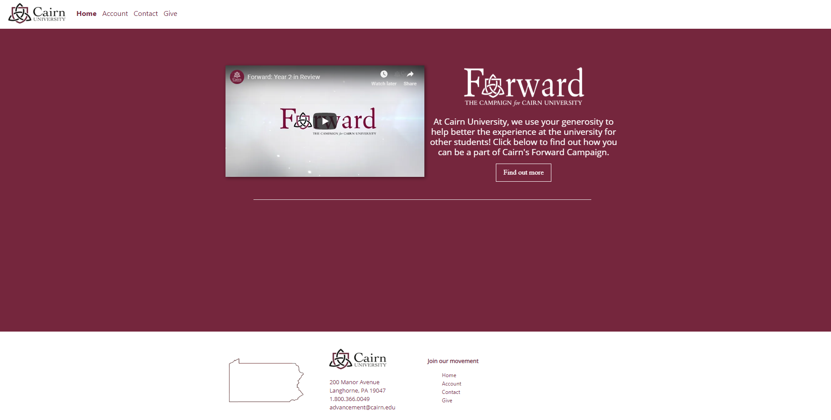
Home Page
Visit the Home Page to watch a quick video on Cairn University’s Forward Campaign
Click the “Find Out More” button to be directed to the Give Page

Slide 7
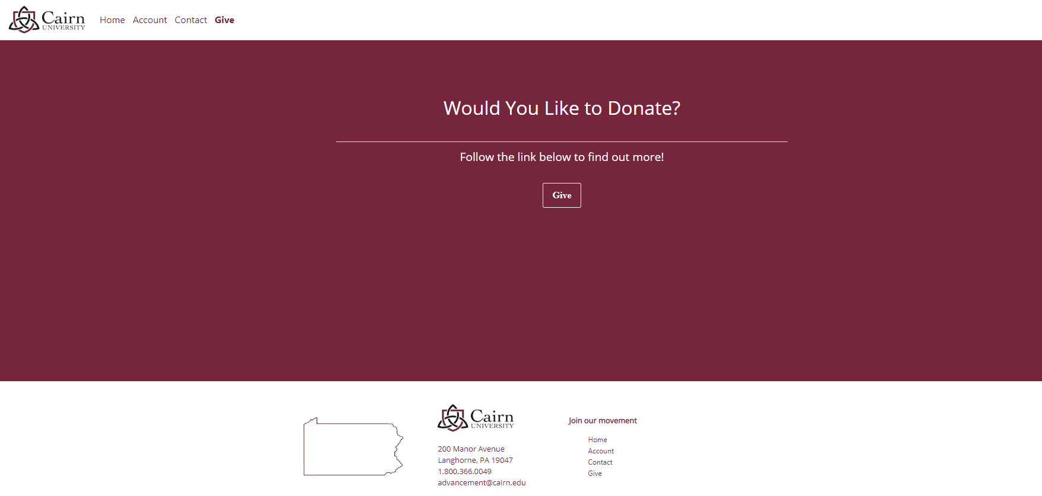
Give to Cairn University
Click the “Give” Button to be directed to Cairn University’s donation page where you can learn more about the Forward Movement and make donations

Slide 8
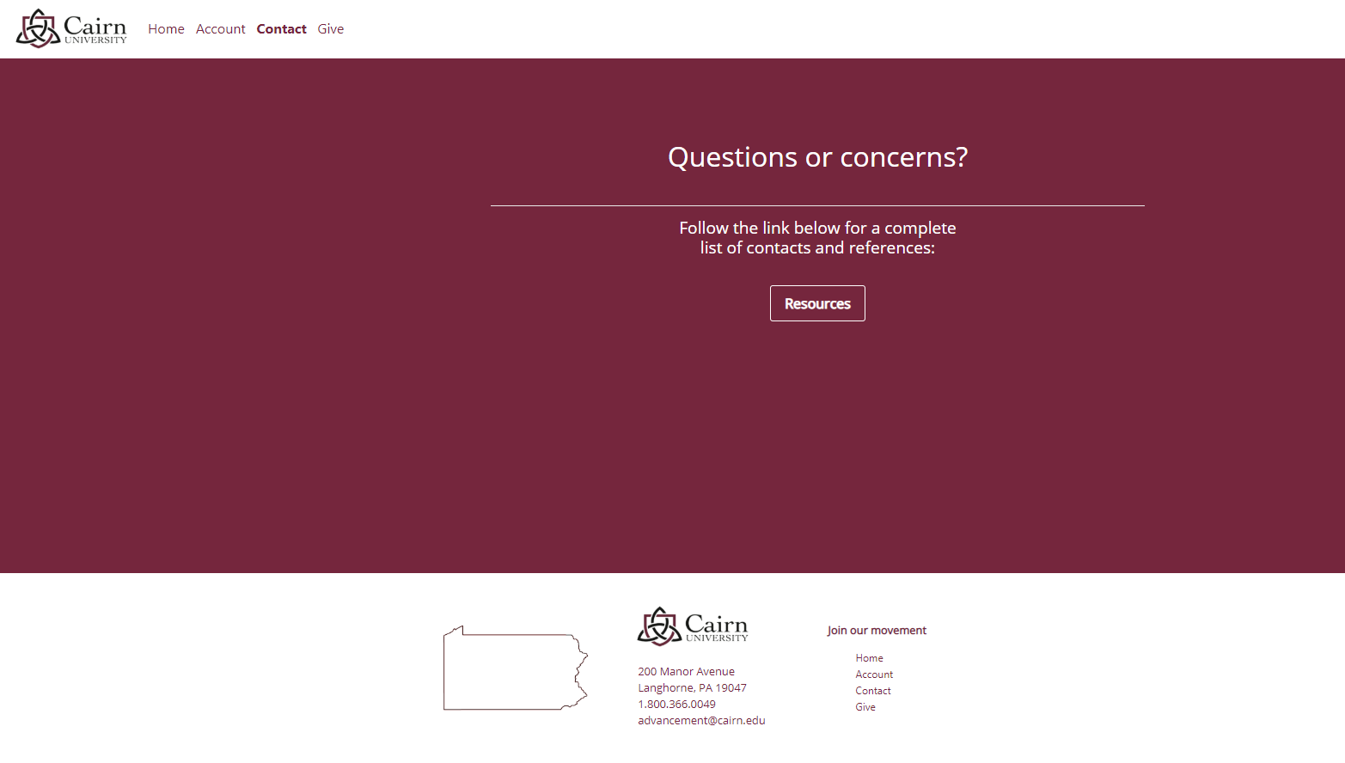
Contact Cairn University
Click the “Resources” button to be directed to Cairn University’s website for a full list of resources

